Slide 1
Firewalls
Corporate Computer Security, 4th Edition
Randall J. Boyle & Raymond R. Panko
Chapter 6

Slide 2
Learning Objectives
Define firewalls in general (basic operation, architecture, and the problem of overload).
Describe how static packet filtering works.
Explain stateful packet inspection (SPI) for main border firewalls.
Describe how network address translation (NAT) works.
Explain application proxy firewalls and content filtering in SPI firewalls.
Distinguish between intrusion detection systems (IDSs) and intrusion prevention systems (IPSs).
Describe antivirus filtering.
Define firewall architectures.
Describe firewall management (defining policies, implementing policies, reading log files).
Describe some difficult problems associated with firewalls.
6-2

Slide 3
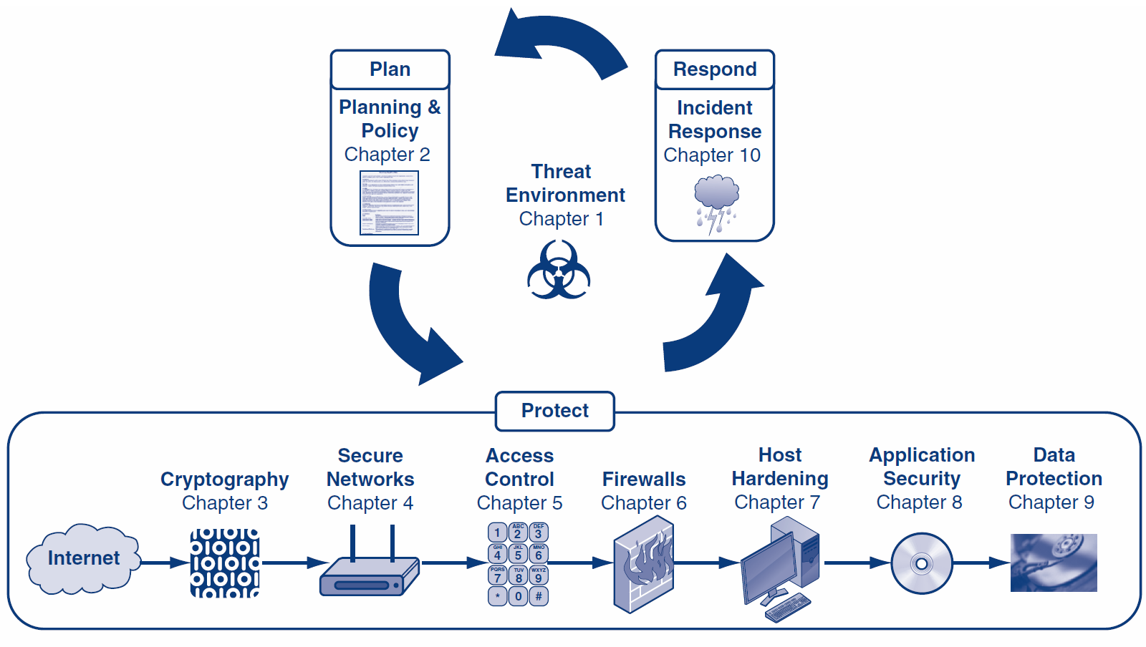
6-3

Slide 4
Orientation
Chapter 5 covered many techniques for access control
This chapter will discuss an additional tool for access control—firewalls
Firewalls filter out traffic that consists of provable attack packets
Firewalls are not security cure-alls, but they are critical to security protection
6-4

Slide 5
What’s Next?
6.1 Introduction
6.2 Static Packet Filtering
6.3 Stateful Packet Inspection (SPI)
6.4 Network Access Translation (NAT)
6.5 Application Proxy Firewalls
6.6 Intrusion Detection Systems (IDSs)
6.7 Antivirus Filtering and Unified Threat Mgt.
6.8 Firewall Architectures
6.9 Firewall Management
6.10 Firewall Filtering Problems

Slide 6
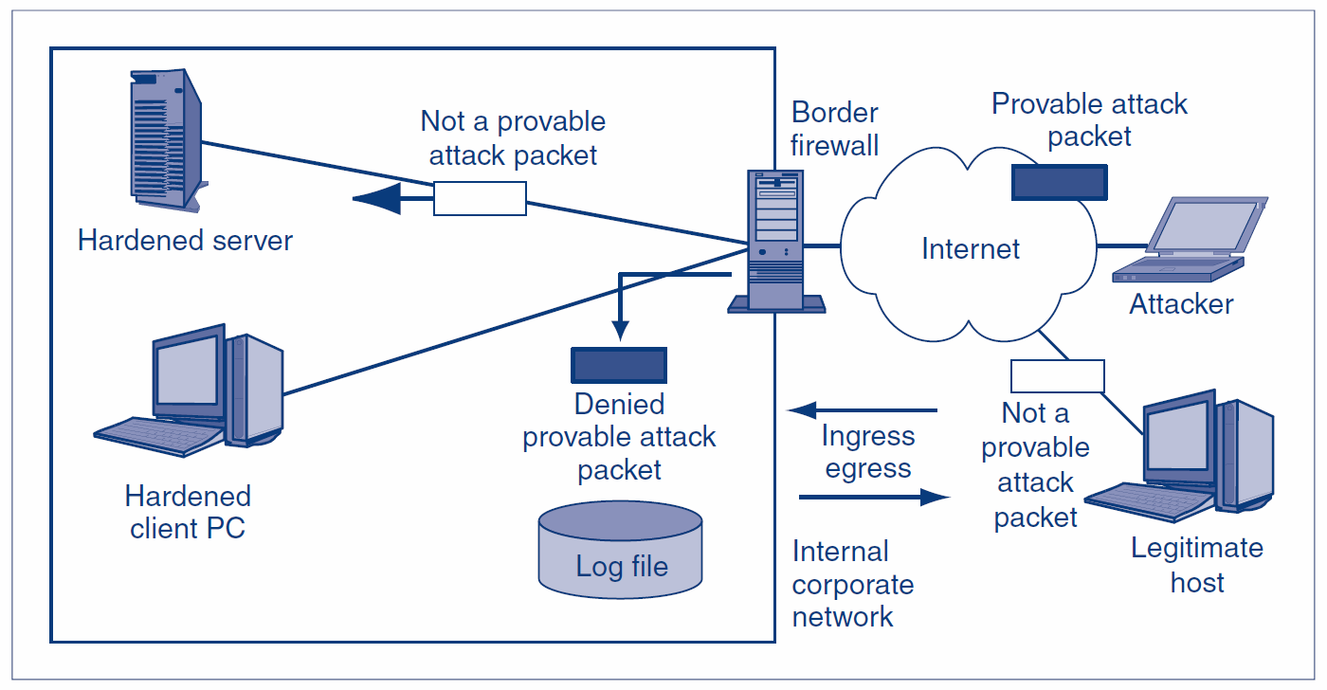
6.1: Basic Firewall Operation
1.
Legitimate hosts send innocent packets.
Attackers send attack packets.
2.
Ingress packets come into a site.
Egress packets go out from a site.
6-6

Slide 7
6.1: Basic Firewall Operation
Firewalls drop and log
provable attack packets
6-7

Slide 8
6.1: Basic Firewall Operation
Firewalls do not drop packets unless they are provably attack packets.
This means that some attack packets that are not provably attack packets get through the firewall.
6-8

Slide 9
6.1: The Danger of Traffic Overload
The Problem
If a firewall cannot filter all of the traffic passing through it, it drops packets it cannot process
This is secure because it prevents attack packets from getting through
It creates a self-inflicted denial-of-service attack by dropping legitimate traffic
6-9

Slide 10
6.1: The Danger of Traffic Overload
Firewall Capacity
Firewalls must have the capacity to handle the incoming traffic volume
Some can handle normal traffic but cannot handle traffic during heavy attacks
They must be able to handle incoming traffic at wire speed—the maximum speed of data coming into each port
6-10

Slide 11
6.1: The Danger of Traffic Overload
Processing Power Is Increasing Rapidly
As processing power increases, more sophisticated filtering methods should become possible
We can even have unified threat management (UTM), in which a single firewall can use many forms of filtering, including antivirus filtering and even spam filtering. (Traditional firewalls do not do these types of application-level malware filtering.)
However, increasing traffic is soaking up much of this increasing processing power
6-11

Slide 12
6.1: The Danger of Traffic Overload
Firewall Filtering Mechanisms
There are many types
We will focus most heavily on the most important firewall filtering method, stateful packet inspection (SPI)
Single firewalls can use multiple filtering mechanisms, most commonly, SPI with other secondary filtering mechanisms
6-12

Slide 13
What’s Next?
6.1 Introduction
6.2 Static Packet Filtering
6.3 Stateful Packet Inspection (SPI)
6.4 Network Access Translation (NAT)
6.5 Application Proxy Firewalls
6.6 Intrusion Detection Systems (IDSs)
6.7 Antivirus Filtering and Unified Threat Mgt.
6.8 Firewall Architectures
6.9 Firewall Management
6.10 Firewall Filtering Problems

Slide 14
6.2: Static Packet Filtering
Static Packet Filtering
This was the earliest firewall filtering mechanism
Limits
Examines packets one at a time, in isolation
Only looks at some internet and transport headers
Consequently, unable to stop many types of attacks
6-14

Slide 15
6.2: Static Packet Filtering
Inspects Packets One at a Time, in Isolation
If it receives a packet containing a SYN/ACK segment, this may be a legitimate response to an internally initiated SYN segment
The firewall must pass packets containing these segments, or internally initiated communications cannot exist
6-15

Slide 16
6.2: Static Packet Filtering
Inspects Packets One at a Time, in Isolation
However, this SYN/ACK segment could be an external attack
It could be sent to elicit an RST segment confirming that there is a victim at the IP address to which the SYN/ACK segment is sent
A static packet filtering firewall cannot stop this attack
6-16

Slide 17
6.2: Static Packet Filtering
Static Packet Filtering Can Stop Certain Attacks Very Efficiently
Incoming ICMP Echo packets and other scanning probe packets
Outgoing responses to scanning probe packets
Packets with spoofed IP addresses (e.g., incoming packets with the source IP addresses of hosts inside the firm)
Packets that have nonsensical field settings, such as a TCP segment with both the SYN and FIN bits set
6-17

Slide 18
6.2: Static Packet Filtering
Market Status
No longer used as the main filtering mechanism for border firewalls
May be used as a secondary filtering mechanism on main border firewalls
6-18

Slide 19
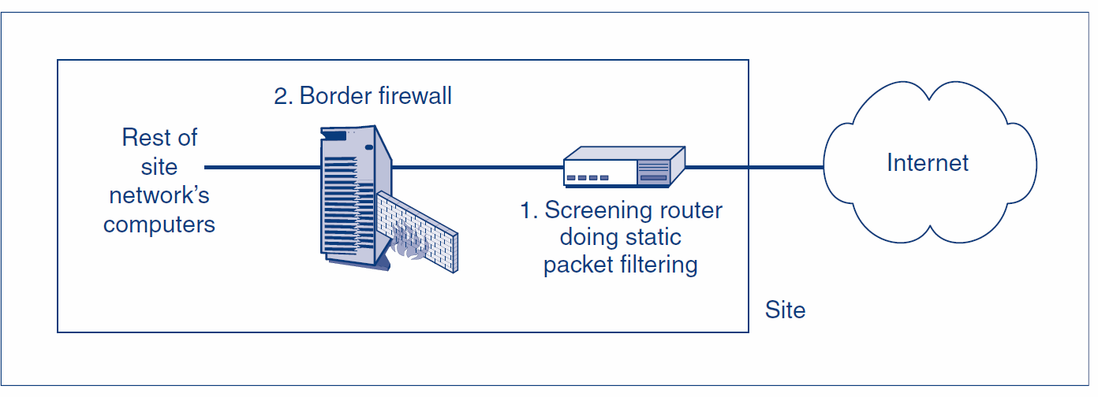
6.2: Static Packet Filtering
Market Status
Also may be implemented in border routers, which lie between the Internet and the firewall
Stops simple, high-volume attacks to reduce the load on the main border firewall
6-19

Slide 20
What’s Next?
6.1 Introduction
6.2 Static Packet Filtering
6.3 Stateful Packet Inspection (SPI)
6.4 Network Access Translation (NAT)
6.5 Application Proxy Firewalls
6.6 Intrusion Detection Systems (IDSs)
6.7 Antivirus Filtering and Unified Threat Mgt.
6.8 Firewall Architectures
6.9 Firewall Management
6.10 Firewall Filtering Problems

Slide 21
6.3: States in a Connection
Connections have distinct states or stages
Different states are subject to different attacks
Stateful firewalls use different filtering rules for different states
Connection Opening
State
Ongoing Communication
State
Connection Closing
State
6-21

Slide 22
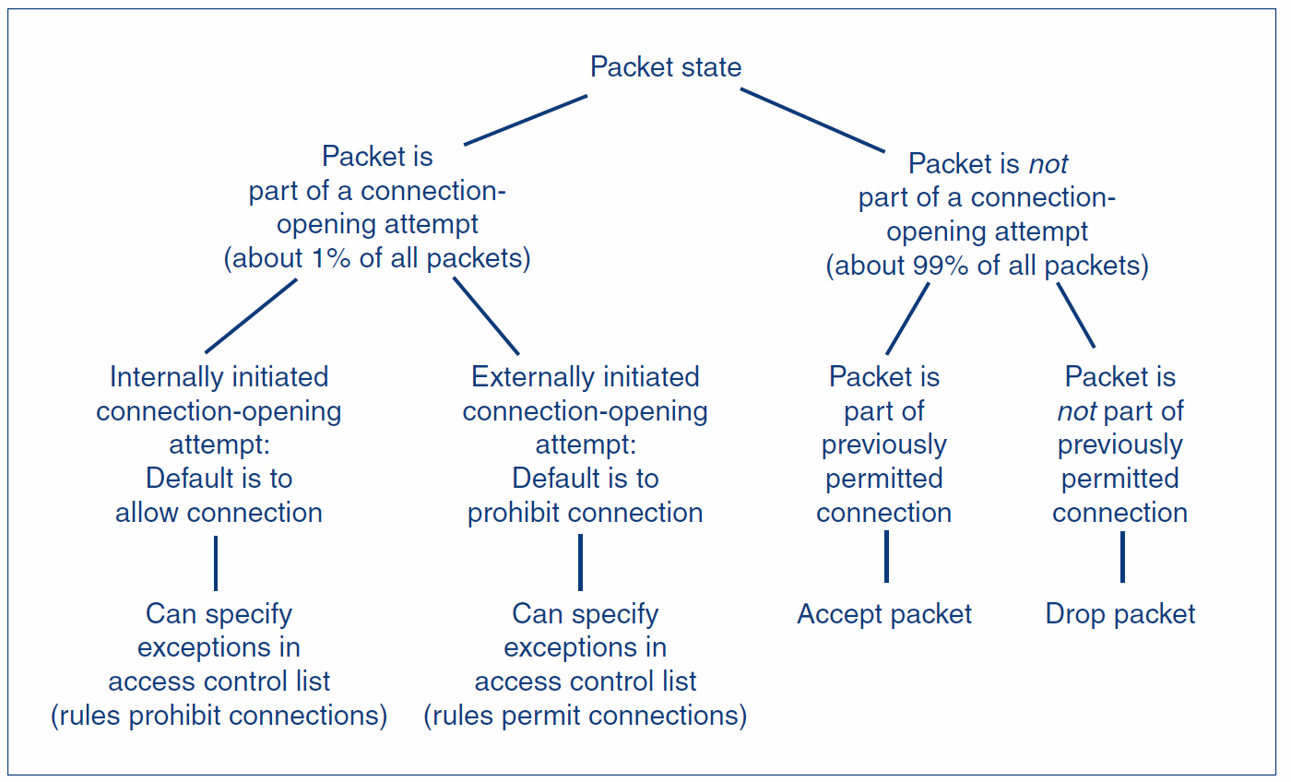
6.3: Stateful Inspection Rules with Two States
6-22

Slide 23
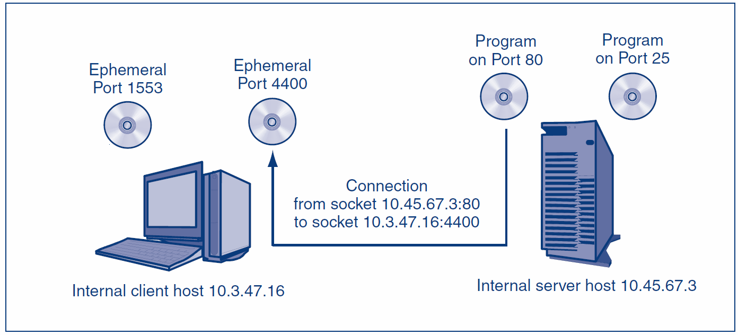
6.3: Connection and Socket
6-23

Slide 24
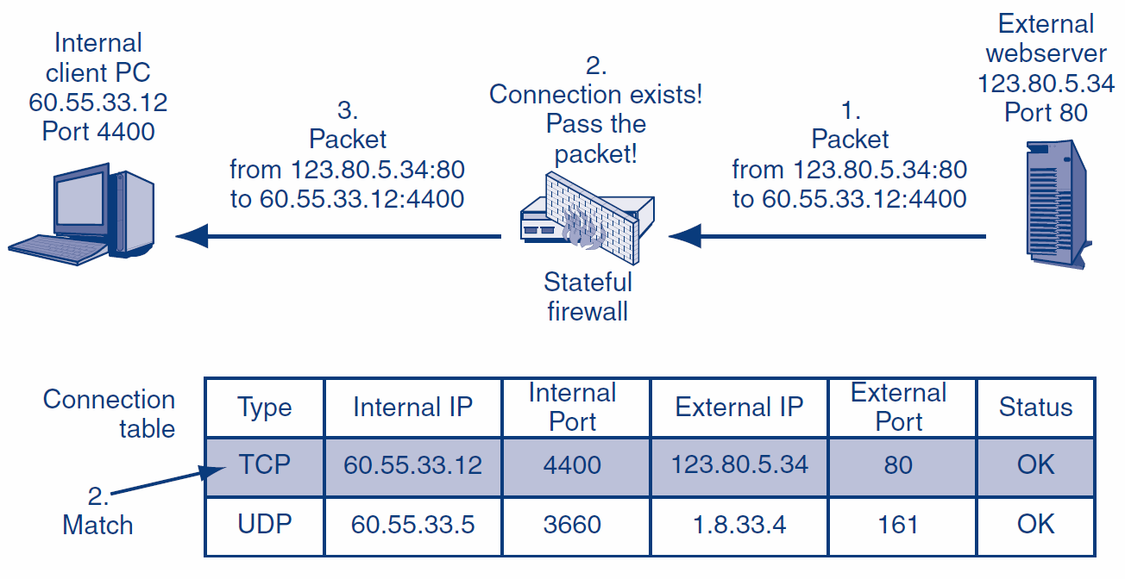
6.3: Stateful Packet Inspection for a Packet that Does Not Attempt to Open a Connection I
6-24

Slide 25
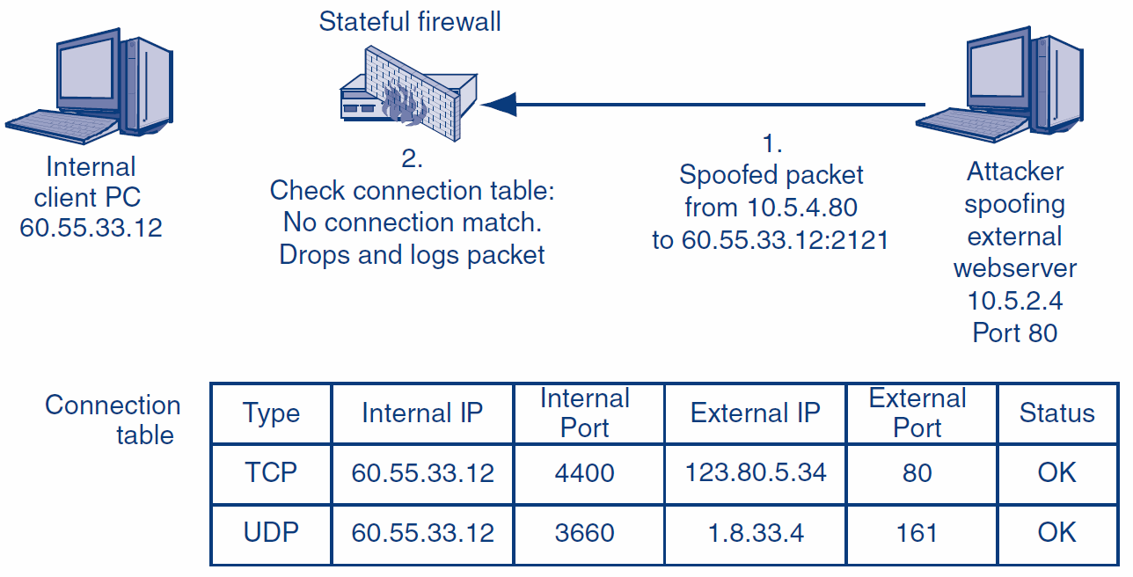
6.3: Stateful Packet Inspection for a Packet that Does Not Attempt to Open a Connection II
6-25

Slide 26
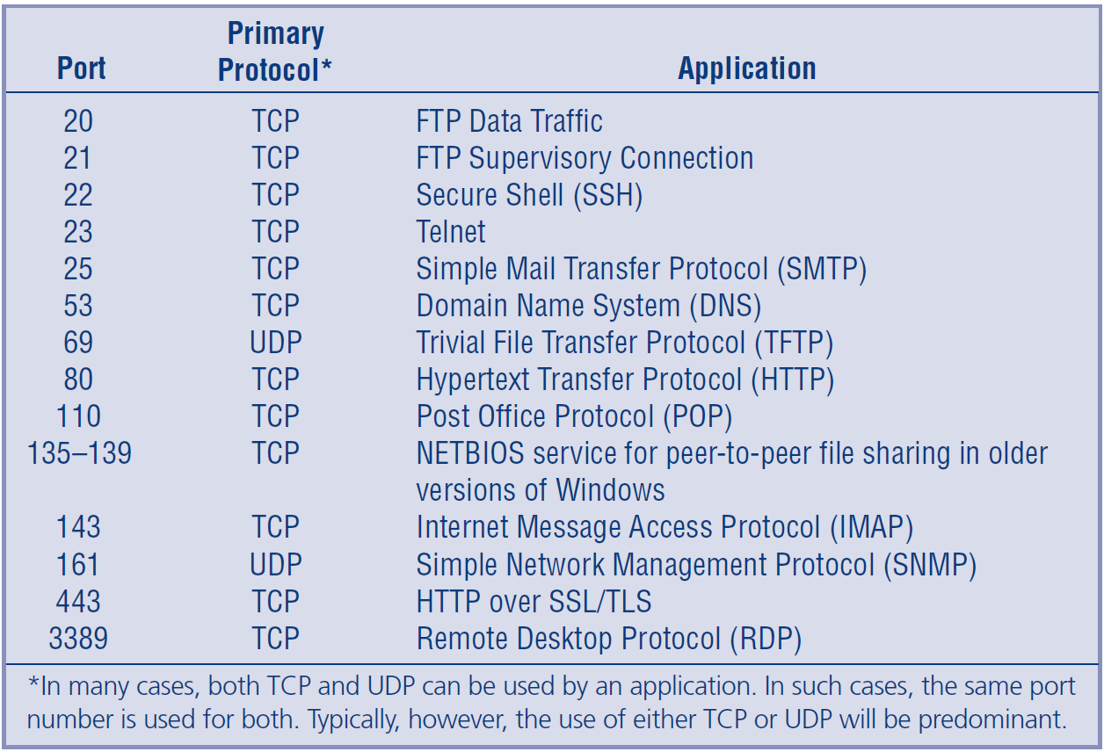
6.3: Well-Known Port Numbers
6-26

Slide 27
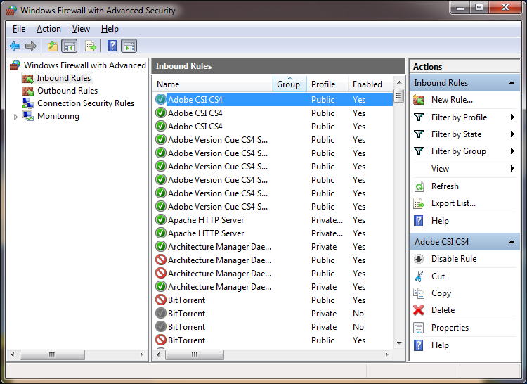
6.3: Windows Firewall
6-27

Slide 28
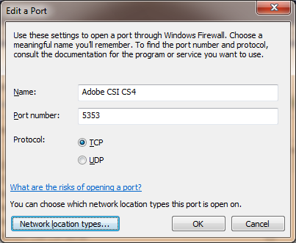
6.3: Open a Port Through Windows Firewall
6-28

Slide 29
6.3: Ingress Access Control List (ACL) in a Stateful Packet Inspection Firewall
Access Control List Operation
An ACL is a series of rules for allowing or disallowing connections
The rules are executed in order, beginning with the first
If a rule DOES NOT apply to the connection-opening attempt, the firewall goes to the next ACL rule
If the rule DOES apply, the firewall follows the rule, and no further rules are executed
If the firewall reaches the last rule in the ACL, it follows that rule
6-29

Slide 30
6.3: Ingress Access Control List (ACL) in a Stateful Packet Inspection Firewall
Ingress ACL’s Purpose
The default behavior is to drop all attempts to open a connection from the outside
All ACL rules except for the last give exceptions to the default behavior under specified circumstances
The last rule applies the default behavior to all connection-opening attempts that are not allowed by earlier rules to be executed by this last rule
6-30

Slide 31
6.3: Ingress Access Control List (ACL) in a Stateful Packet Inspection Firewall
Simple Ingress ACL with Three Rules
If TCP destination port = 80 or TCP destination port = 443, then Allow Connection
[Permits connection to ALL internal webservers]
If TCP destination port = 25 AND IP destination address = 60.47.3.35, then Allow Connection
[Permits connections to a SINGLE internal mail server]
Disallow ALL Connections
[Disallows all other externally initiated connections; this is the default behavior]
6-31

Slide 32
6.3: Perspective on SPI Firewalls
Low Cost
Most packets are not part of packet-opening attempts
These can be handled very simply and therefore inexpensively
Connection-opening attempt packets are more expensive processes but are rare
6-32

Slide 33
6.3: Perspective on SPI Firewalls
Safety
Attacks other than application-level attacks usually fail to get through SPI firewalls
In addition, SPI firewalls can use other forms of filtering when needed
6-33

Slide 34
6.3: Perspective on SPI Firewalls
Dominance
The combination of high safety and low cost makes SPI firewalls extremely popular
Nearly all main border firewalls today use stateful packet inspection
6-34

Slide 35
What’s Next?
6.1 Introduction
6.2 Static Packet Filtering
6.3 Stateful Packet Inspection (SPI)
6.4 Network Access Translation (NAT)
6.5 Application Proxy Firewalls
6.6 Intrusion Detection Systems (IDSs)
6.7 Antivirus Filtering and Unified Threat Mgt.
6.8 Firewall Architectures
6.9 Firewall Management
6.10 Firewall Filtering Problems

Slide 36
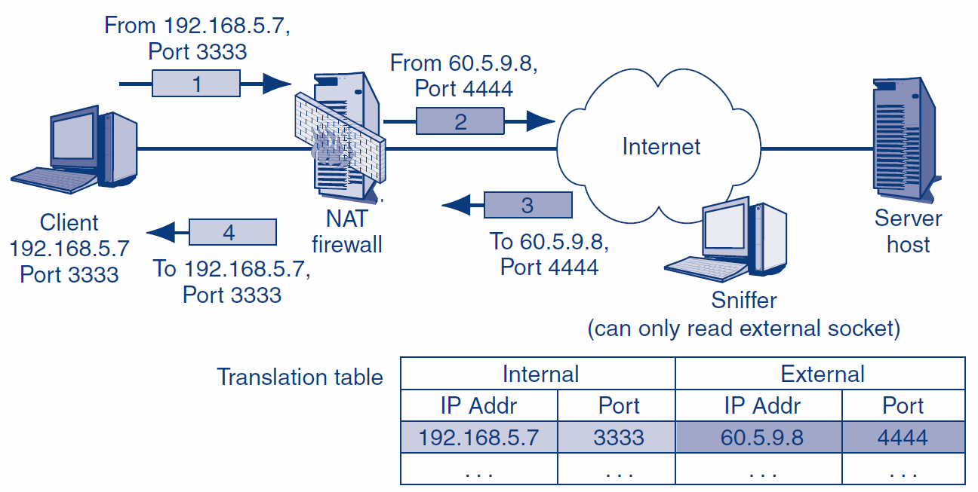
6.4: Network Address Translation (NAT)
6-36

Slide 37
What’s Next?
6.1 Introduction
6.2 Static Packet Filtering
6.3 Stateful Packet Inspection (SPI)
6.4 Network Access Translation (NAT)
6.5 Application Proxy Firewalls
6.6 Intrusion Detection Systems (IDSs)
6.7 Antivirus Filtering and Unified Threat Mgt.
6.8 Firewall Architectures
6.9 Firewall Management
6.10 Firewall Filtering Problems

Slide 38
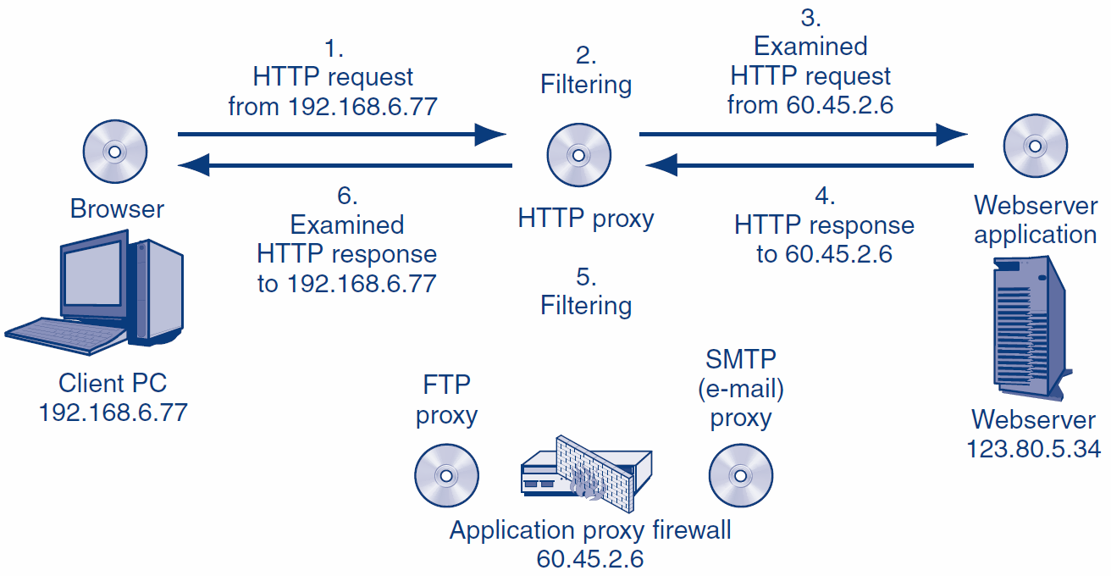
6.5: Application Proxy Firewall Operation
6-38

Slide 39
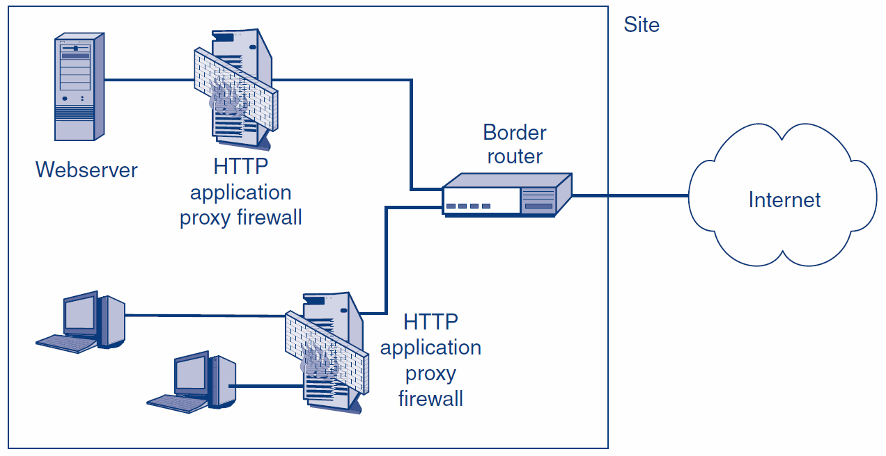
6.5: Roles for Application Proxy Firewalls Today
6-39

Slide 40
6.5: Application Content Filtering in Application Proxy Firewalls and Stateful Packet Inspection Firewalls
Topic | Application Proxy Firewalls | Stateful Packet Inspection Firewalls | Remarks
Can examine application layer content | Always | As an Extra Feature
Capabilities for application layer content filtering | Somewhat More | Somewhat Less
6-40

Slide 41
6.5: Application Content Filtering in Application Proxy Firewalls and Stateful Packet Inspection Firewalls
Topic | Application Proxy Firewalls | Stateful Packet Inspection Firewalls | Remarks
Uses Relay Operation with two connections per client/server pair? | Yes | No | Maintaining two connections is highly processing-intensive. Cannot support many client/server pairs. Consequently, application proxy firewalls cannot be used as main border firewalls.
Speed | Slow | Fast
6-41

Slide 42
6.5: Tor Routing
Tor directory server
Tor Node 1
Tor Node 2
Tor Node 8
1. List of Tor nodes
3. Unencrypted link at exit node
Tor Node 3
2. Encrypted Path
User
Tor Node 7
Tor Node 4
Webserver
Tor Node 6
Tor Node 5
6-42

Slide 43
6.5: Alternate TOR Route
Tor directory server
Tor Node 1
Tor Node 2
Tor Node 8
1. List of Tor nodes
2. Alternate Path
Tor Node 3
User
Tor Node 7
Tor Node 4
Webserver
3. Unencrypted link at exit node
Tor Node 6
Tor Node 5
6-43

Slide 44
6.5: Application Proxy Firewall Protections
Protections for Internal Clients against Malicious Webservers
URL blacklists for known attack sites
Protection against some or all scripts in webpages
The disallowing of HTTP response messages with prohibited MIME types that indicate malware
Protections against Misbehaving Internal Clients
Disallowing the HTTP POST method, which can be use to send out sensitive files
6-44

Slide 45
6.5: Application Proxy Firewall Protections
Protections for Internal Webservers against Malicious Clients
Disallow HTTP POST methods, which could allow malware files to be placed on the server
Indications of SQL injection attacks
6-45

Slide 46
6.5: Application Proxy Firewall Protections
Automatic Protections
The hiding of internal host IP addresses from sniffers
Header destruction
The data link, internet, and transport headers are discarded—along with any attacks they may have contained
Protocol fidelity
If the client or server does not follow the protocol of the indicated port number, communication with the firewall automatically breaks down
6-46

Slide 47
What’s Next?
6.1 Introduction
6.2 Static Packet Filtering
6.3 Stateful Packet Inspection (SPI)
6.4 Network Access Translation (NAT)
6.5 Application Proxy Firewalls
6.6 Intrusion Detection Systems (IDSs)
6.7 Antivirus Filtering and Unified Threat Mgt.
6.8 Firewall Architectures
6.9 Firewall Management
6.10 Firewall Filtering Problems

Slide 48
6.6: Intrusion Detection Systems (IDSs) and Intrusion Prevention Systems (IPSs)
Perspective
Growing processing power made stateful packet inspection possible
Now, growing processing power is making a new firewall filtering method attractive
Intrusion prevention systems (IPSs)
6-48

Slide 49
6.6: Intrusion Detection Systems (IDSs) and Intrusion Prevention Systems (IPSs)
Intrusion Detection Systems (IDSs)
Firewalls drop provable attack packets only
Intrusion detection systems (IDSs) look for suspicious traffic
Cannot drop because the packet is merely suspicious
Sends an alarm message if the attack appears to be serious
6-49

Slide 50
6.6: Intrusion Detection Systems (IDSs) and Intrusion Prevention Systems (IPSs)
Intrusion Detection Systems (IDSs)
Problem: Too many false positives (false alarms)
Alarms are ignored or the system is discontinued
Can reduce false positives by tuning the IDSs
Eliminate inapplicable rules, such as a Unix rule in an all-Windows company
Reduce the number of rules allowed to generate alarms
Most alarms will still be false alarms
6-50

Slide 51
6.6: Intrusion Detection Systems (IDSs) and Intrusion Prevention Systems (IPSs)
Intrusion Detection Systems (IDSs)
Problem: Heavy processing requirements because of sophisticated filtering
Deep packet inspection
Looks at application content and transport and internet headers
Packet stream analysis
Looks at patterns across a series of packets
Often, patterns cannot be seen unless many packets are examined
6-51

Slide 52
6.6: Intrusion Detection Systems (IDSs) and Intrusion Prevention Systems (IPSs)
Intrusion Prevention Systems (IPSs)
Use IDS filtering mechanisms
Application-specific integrated circuits (ASICs) provide the needed processing power
6-52

Slide 53
6.6: Intrusion Detection Systems (IDSs) and Intrusion Prevention Systems (IPSs)
Intrusion Prevention Systems (IPSs)
Attack confidence identification spectrum
Somewhat likely
Very likely
Provable
Firm may allow firewall to stop traffic at the high end of the attack confidence spectrum
Firm decides which attacks to stop
This allows it to manage its risks
6-53

Slide 54
6.6: Intrusion Detection Systems (IDSs) and Intrusion Prevention Systems (IPSs)
Possible Actions
Drop packets
Risky for suspicious traffic even with high confidence
Bandwidth limitation for certain types of traffic
Limit to a certain percentage of all traffic
Less risky than dropping packets
Useful when confidence is lower
6-54

Slide 55
What’s Next?
6.1 Introduction
6.2 Static Packet Filtering
6.3 Stateful Packet Inspection (SPI)
6.4 Network Access Translation (NAT)
6.5 Application Proxy Firewalls
6.6 Intrusion Detection Systems (IDSs)
6.7 Antivirus Filtering and Unified Threat Mgt.
6.8 Firewall Architectures
6.9 Firewall Management
6.10 Firewall Filtering Problems

Slide 56
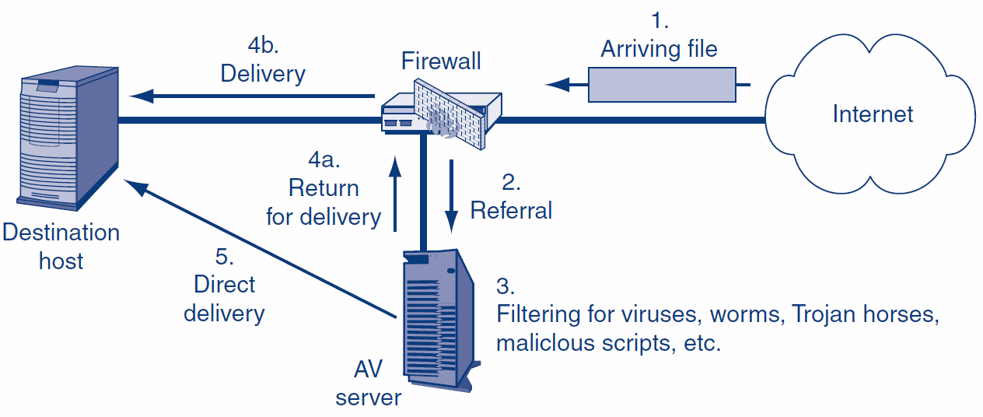
6.7: Firewalls and Antivirus Servers
Traditional Firewalls Do Not Do Antivirus Filtering
They Pass Files Needing Filtering to an Antivirus Server
6-56

Slide 57
6.7: Unified Threat Management (UTM)
Unified Threat Management (UTM) Firewalls Go Beyond Traditional Firewall Filtering
SPI
Antivirus Filtering
VPNs
DoS Protection
NAT
6-57

Slide 58
6.7: Stopping Denial-of-Service (DoS) Attacks
Perspective
Done by most main border firewalls
DOS attacks are easy to detect but difficult to stop because their traffic looks like legitimate packets
6-58

Slide 59


6.7: Stopping Denial-of-Service (DoS) Attacks
SYN
SYN/ ACK
TCP Half-Opening Attacks
Attacks
Attacker sends a TCP SYN segment to a port
The application program sends back a SYN/ACK segment and sets aside resources
The attacker never sends back an ACK, so the victim keeps the resources reserved
The victim soon runs out of resources and crashes or can no longer serve legitimate traffic
No ACK
SYN
6-59

Slide 60

6.7: Stopping Denial-of-Service (DoS) Attacks
SYN
SYN/ ACK
TCP Half- Opening Attacks
Defenses
Firewall intercepts the SYN from an external host
Firewall sends back a SYN/ACK without passing the segment on to the target host
Only if the firewall receives a timely ACK does it send the original SYN the destination host
No ACK
6-60

Slide 61
6.7: Stopping Denial-of-Service (DoS) Attacks
Rate Limiting
Set a limit on all traffic to a server—both legitimate and DoS packets
Keeps the entire network from being overloaded
Not perfect—does not protect the target server or allow legitimate traffic
6-61

Slide 62
6.7: Stopping Denial-of-Service (DoS) Attacks
DoS Protection Is a Community Problem
If an organization’s access line to the Internet becomes overloaded, it cannot solve the problem itself
Its ISP or other upstream agencies must help
6-62

Slide 63
What’s Next?
6.1 Introduction
6.2 Static Packet Filtering
6.3 Stateful Packet Inspection (SPI)
6.4 Network Access Translation (NAT)
6.5 Application Proxy Firewalls
6.6 Intrusion Detection Systems (IDSs)
6.7 Antivirus Filtering and Unified Threat Mgt.
6.8 Firewall Architectures
6.9 Firewall Management
6.10 Firewall Filtering Problems

Slide 64
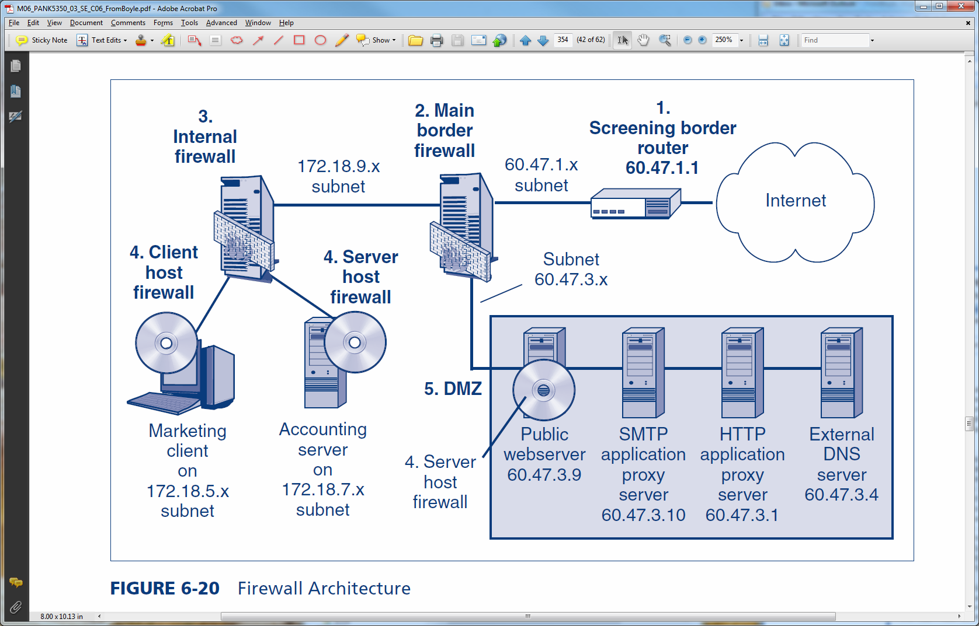
6.8: Firewall Architecture
A firm has many firewalls:
Screening border routers
Main border firewalls
Internal firewalls
Host firewalls on clients and servers
The firewall architecture describes how these firewalls work together.
6-64

Slide 65
6.8: The Demilitarized Zone (DMZ)
DMZs Use Multi-Homed Main Firewalls
One subnet to the border router
One subnet to the DMZ (accessible to the outside world)
One subnet to the internal network
Access from the internal subnet to the Internet is nonexistent or minimal
Access from the internal subnet to the DMZ is also strongly controlled
Internal
Network
Border
Router
DMZ
6-65

Slide 66
6.8: The Demilitarized Zone (DMZ)
Demilitarized Zone (DMZ)
Subnet for servers and application proxy firewalls accessible via the Internet
Hosts in the DMZ must be especially hardened because they will be accessible to attackers on the Internet
6-66

Slide 67
6.8: The Demilitarized Zone (DMZ)
Hosts in the DMZ
Public servers (public webservers, FTP servers, etc.)
Application proxy firewalls to require all Internet traffic to pass through the DMZ
External DNS server that knows only host names in the DMZ
6-67

Slide 68
What’s Next?
6.1 Introduction
6.2 Static Packet Filtering
6.3 Stateful Packet Inspection (SPI)
6.4 Network Access Translation (NAT)
6.5 Application Proxy Firewalls
6.6 Intrusion Detection Systems (IDSs)
6.7 Antivirus Filtering and Unified Threat Mgt.
6.8 Firewall Architectures
6.9 Firewall Management
6.10 Firewall Filtering Problems

Slide 69
6.9: Firewall Management
Firewalls Are Ineffective Without Planning and Ongoing Management
Defining Firewall Policies
Policies are high-level statements about what to do
E.g., HTTP connections from the Internet may only go to servers in the DMZ
6-69

Slide 70
6.9: Firewall Management
Defining Firewall Policies
Policies are more comprehensible than actual firewall rules
There may be multiple ways to implement a policy
Defining policies instead of specific rules gives implementers freedom to choose the best way to implement a policy
6-70

Slide 71
6.9: Firewall Management
Implementation
Firewall hardening
Firewall appliances are hardened at the factory
Vendors sell software plus a server with a pre-hardened operating system
Firewall software on a general-purpose computer requires the most on-site hardening
6-71

Slide 72


6.9: Firewall Management
Implementation
Central firewall management systems
Creates a policy database
Changes policies into ACL rules
Sends ACL rules out to individual firewalls
Firewall
Administrator
Policy
Server
Policy
ACL Rule
ACL Rule
6-72

Slide 73
6.9: Firewall Policy Database
Policy | Source | Destination | Service | Action | Track | Firewalls
1 | Internal | DNS Servers | UDP dns | Pass | None | All
2 | External | Internal | TCP http | Drop | Log | All
3 | External | DMZ webserver | TCP http | Pass | None | Border
4 | Internal | External | TCP http | Pass | Log | Border
5 | Internal | External | ICMP | Drop | None | Border
6 | Internal | Mail Server | TCP smtp | Authenticate | Log if Fail | Central
7 | Marketing | Plans Server | TCP http | Authenticate | Alert if Fail | Marketing
8 | Any | Plans Server | TCP http | Drop | Log | Marketing
9 | Any | Any | Any | Drop | Log | All
6-73

Slide 74
6.9: Firewall Management
Implementation
Vulnerability testing after configuration
There will be problems
Tests, like firewall configuration, should be based on policies
6-74

Slide 75
6.9: Firewall Management
Implementation
Change authorization and management
Limit the number of people who can make change requests
Limit the number of authorizers even more
Require requesters and authorizers to be different people
Implement the rule in the most restrictive way possible—
To pass the least number of packets
6-75

Slide 76
6.9: Firewall Management
Implementation
Change authorization and management
Document all changes carefully
Do vulnerability testing after every change
The change should work
All previous behaviors should still work (regression testing)
Audit changes frequently
Focus especially on asking if each change opens the firewall in the most restrictive way possible
6-76

Slide 77
6.9: Firewall Management
Implementation
Reading the firewall logs
Should be done daily or more frequently
The most labor-intensive part of firewall management
Strategy is to find unusual traffic patterns
Top ten source IP addresses whose packets were dropped
Number of DNS failures today versus in an average day
Attackers can be black holed (have their packets dropped)
6-77

Slide 78
6.9: Ingress Firewall Log File
ID | Time | Rule | Source IP | Destination IP | Service
1 | 15:34:005 | Echo Probe | 14.17.3.139 | 60.3.87.6 | ICMP
2 | 15:34:007 | Echo Probe | 14.17.3.139 | 60.3.87.7 | ICMP
3 | 15:34:008 | Forbidden Webserver Access | 128.171.17.3 | 60.17.14.8 | HTTP
4 | 15:34:012 | External Access to Internal FTP Server | 14.8.23.96 | 60.8.123.56 | FTP
5 | 15:34:015 | Echo Probe | 14.17.3.139 | 60.3.87.8 | ICMP
6 | 15:34:020 | External Access to Internal FTP Server | 128.171.17.34 | 60.19.8.20 | FTP
7 | 15:34:021 | Echo Probe | 1.124.82.6 | 60.14.42.68 | ICMP
8 | 15:34:023 | External Access to Internal FTP Server | 14.17.3.139 | 24.65.56.97 | FTP
9 | 15:34:040 | External Access to Internal FTP Server | 14.17.3.139 | 60.8.123.56 | FTP
6-78

Slide 79
6.9: Ingress Firewall Log File
ID | Time | Rule | Source IP | Destination IP | Service
10 | 15:34:047 | Forbidden Webserver Access | 128.171.17.3 | 60.17.14.8 | HTTP
11 | 15:34:048 | Echo Probe | 14.17.3.139 | 60.3.87.9 | ICMP
12 | 15:34:057 | Echo Probe | 1.30.7.45 | 60.32.29.102 | ICMP
13 | 15:34:061 | External Packet with Private IP Source Address | 10.17.3.139 | 60.32.29.102 | ICMP
14 | 15:34:061 | External Access to Internal FTP Server | 1.32.6.18 | 60.8.123.56 | FTP
15 | 15:34:062 | Echo Probe | 14.17.3.139 | 60.3.87.10 | ICMP
16 | 15:34:063 | Insufficient Capacity | 1.32.23.8 | 60.3.12.47 | DNS
17 | 15:34:064 | Echo Probe | 14.17.3.139 | 60.3.87.11 | ICMP
18 | 15:34:065 | Forbidden Webserver Access | 128.171.17.3 | 60.17.14.8 | HTTP
6-79

Slide 80
What’s Next?
6.1 Introduction
6.2 Static Packet Filtering
6.3 Stateful Packet Inspection (SPI)
6.4 Network Access Translation (NAT)
6.5 Application Proxy Firewalls
6.6 Intrusion Detection Systems (IDSs)
6.7 Antivirus Filtering and Unified Threat Mgt.
6.8 Firewall Architectures
6.9 Firewall Management
6.10 Firewall Filtering Problems

Slide 81
6.10: The Death of the Perimeter
Protecting the Perimeter Is No Longer Possible
There are too many ways to get through the perimeter
Avoiding the Border Firewall
Internal attackers are inside the firewall already
Compromised internal hosts are inside the firewall
Wireless LAN drive-by hackers enter through access points that are inside the site
Home notebooks, mobile phones, and media brought into the site
Internal firewalls can address some of these threats
6-81

Slide 82
6.10: The Death of the Perimeter
Extending the Perimeter
Remote employees must be given access
Consultants, outsourcers, customers, suppliers, and other subsidiaries must be given access
Essentially, all of these tend to use VPNs to make external parties “internal” to your site
6-82

Slide 83
6.10: Signature versus Anomaly Detection
Most Filtering Methods Use Attack Signature Detection
Each attack has a signature
This attack signature is discovered
The attack signature is added to the firewall
Zero-day attacks are attacks without warning, and occur before a signature is developed
Signature defense cannot stop zero-day attacks
6-83

Slide 84
6.10: Signature versus Anomaly Detection
Anomaly Detection
Detects an unusual pattern indicating a possible attack
This is difficult, so there are many false positives
Shrinking time needed to define signatures
Anomaly detection is necessary in today’s firewalls
6-84

Slide 85
The End

Slide 86
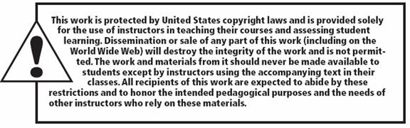
All rights reserved. No part of this publication may be reproduced, stored in a retrieval system, or transmitted, in any form or by any means, electronic, mechanical, photocopying, recording, or otherwise, without the prior written permission of the publisher. Printed in the United States of America.
Copyright © 2015 Pearson Education, Inc.

